Slide 1
DOOM AI
Digital Observatory of Our Multiverse
Global Intelligence Command Center
META GLOBAL AI DEVELOPER HACKATHON 2026
Indie Developer Track | Build for Your World
Developed by: ABINESH BOOPAL
One Platform | Seven Missions | A World of Discovery

Slide 2
PROJECT OVERVIEW
DOOM AI - Digital Observatory of Our Multiverse
DOOM AI is a Global Intelligence Command Centre developed for the Meta Global AI Developer Hackathon 2026.
The application brings together seven interactive missions covering communication, Earth, space, aviation, message impact, planetary exploration, and wildlife conservation.
It combines Meta AI-assisted language features, public scientific data sources, interactive 3D visualisations, and educational simulations.
My Goal: To make complex global information easier to explore, understand, and learn from through one unified platform.

Slide 3
WHY I BUILT DOOM AI
THE PROBLEM
Information about Earth, space, aviation, wildlife, and communication is spread across different websites and applications.
Many existing tools present complex information that can be difficult for beginners to understand.
MY MOTIVATION
I wanted to create one interactive platform where people can explore different subjects without switching between many applications.
MY SOLUTION
DOOM AI brings seven missions together through one Global Intelligence Command Center.
It combines AI-assisted features, public data, 3D visualizations, and educational activities.
It clearly distinguishes real observations from reference information and simulated demonstrations.

Slide 4
PROJECT OBJECTIVES
MAIN OBJECTIVE
To develop one unified Global Intelligence Command Center that makes complex information easier to explore through seven interactive missions.
TECHNICAL OBJECTIVES
Integrate Meta AI-assisted communication features, public scientific APIs, and interactive 3D visualizations.
Present observed, reference, and simulated information clearly without misleading users.
EDUCATIONAL OBJECTIVES
Support learning about Earth, space, aviation, communication, and wildlife conservation through visual exploration and interactive challenges.
TARGET USERS
Students, educators, science enthusiasts, environmental learners, and the general public.

Slide 5
DEVELOPMENT TOOLS AND TECHNOLOGIES
DEVELOPMENT ENVIRONMENT
Visual Studio Code (VS Code) - Used to write, edit, debug, and organize the project source code.
Python 3.13 - Main programming language for the desktop application, API integration, and mission controllers.
Windows and PowerShell - Used for local development, running Python scripts, and testing.
APPLICATION DEVELOPMENT
Tkinter - Used to build the desktop Command Center and communication interfaces.
HTML, CSS, and JavaScript - Used to develop interactive browser-based mission dashboards.
Globe.gl / Three.js - Used to display interactive 3D Earth visualizations, markers, and movement.
AI AND VERSION CONTROL
Meta Muse Spark 1.3 API - Integrated for AI-assisted communication and explanations

Slide 6
APIs AND TECHNICAL INTEGRATIONS
META MODEL API - MUSE SPARK 1.3
Supports AI-assisted language processing, rewriting, translation, and explanations in the configured communication features.
EARTH AND ENVIRONMENTAL DATA
Open-Meteo - Weather information and forecasts.
USGS Earthquake API - Public earthquake observations.
NASA Worldview and EONET - Earth imagery and natural-event information.
OpenStreetMap Nominatim - Geographic place search.
SPACE AND AVIATION DATA
CelesTrak and Skyfield - Satellite orbital data and position calculations.
NASA services - Space imagery and astronomy information.
TheSpaceDevs - Rocket launch information where available.
OpenSky Network - Publicly observed aircraft positions and headings.
OTHER LIBRARIES
gTTS and pygame - Text-to-speech and audio playback.
Globe.gl - Interactive 3D geographic visualizations.

Slide 7
COMMUNICATION INTELLIGENCE
AI COMMUNICATION
AI-assisted multilingual communication using Meta Muse Spark 1.3.
Supports language translation, message rewriting, and communication improvement.
Includes text-to-speech features for supported languages.
PURPOSE
Help users communicate more clearly across different languages and situations.

Slide 8
Technical Implementation
HOW THE MISSION WORKS
The user enters a message and selects a communication feature.
The Python application processes the request and uses the configured Meta Muse Spark 1.3 API for supported AI-assisted operations.
The result is displayed in the desktop interface for the user to review.
TECHNOLOGIES USED
Python 3.13 - Application logic and API communication.
Tkinter - Graphical user interface.
Meta Muse Spark 1.3 API - AI-assisted translation, rewriting, and language processing.
gTTS - Converts supported text into speech.
pygame - Plays generated speech audio.
WHY META AI?
To help users express ideas more clearly and communicate across languages.

Slide 9
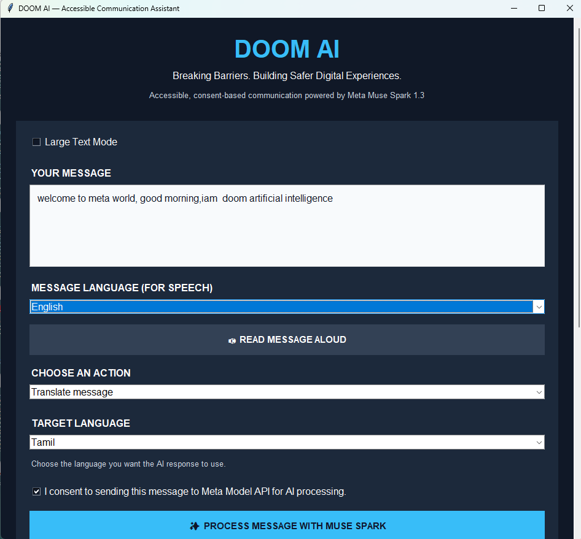
Communication Intelligence - User Interface

Slide 10
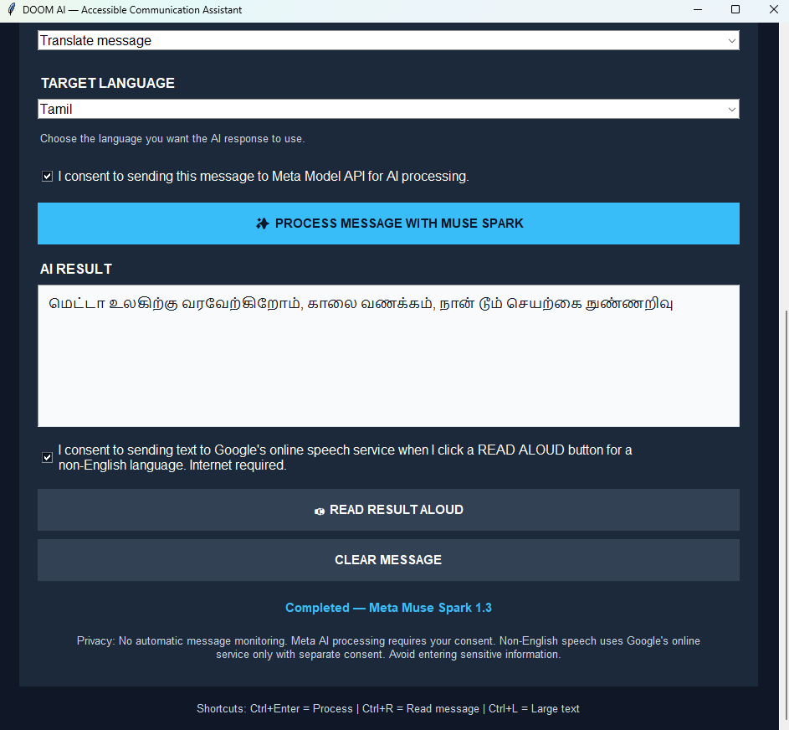
Communication Intelligence- Translation Result

Slide 11
NATURE AND EARTH INTELLIGENCE
MAIN FEATURES
Interactive 3D Earth globe for exploring geographic locations and environmental information.
Weather conditions and forecasts using the Open-Meteo API.
Earthquake information from the USGS Earthquake API.
NASA Worldview imagery and EONET natural-event information, including wildfire events.
Location search using OpenStreetMap Nominatim.
TECHNOLOGIES USED
Python, Tkinter, HTML, CSS, JavaScript, Globe.gl, Open-Meteo, USGS, NASA services, and Nominatim.
PURPOSE
To make Earth science and environmental information easier to explore, visualize, and understand.
DATA NOTE
Weather and natural-event information depends on public API availability and update frequency.

Slide 12
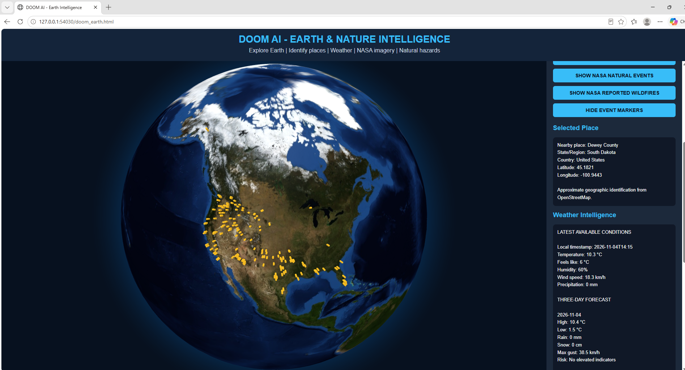
NATURE & EARTH INTELLIGENCE - WILDFIRE MONITORING & WEATHER

Slide 13
SPACE INTELLIGENCE
SPACE EXPLORATION
MAIN FEATURES
ISS position tracking on an interactive 3D Earth globe.
Satellite network visualisation using calculated orbital positions.
Rocket launch explorer showing mapped launch sites.
NASA image gallery and Astronomy Picture of the Day.
Official space streaming links and Muse AI astronomy assistance.
TECHNOLOGIES USED
Python, HTML, JavaScript, Globe.gl, Skyfield, CelesTrak, NASA services, TheSpaceDevs, and Meta Muse Spark API integration.
PURPOSE
To help users explore space science, satellite movement, and rocket launches through interactive visualization.
DATA NOTE
Satellite positions are calculated from published orbital elements, not live satellite telemetry.

Slide 14
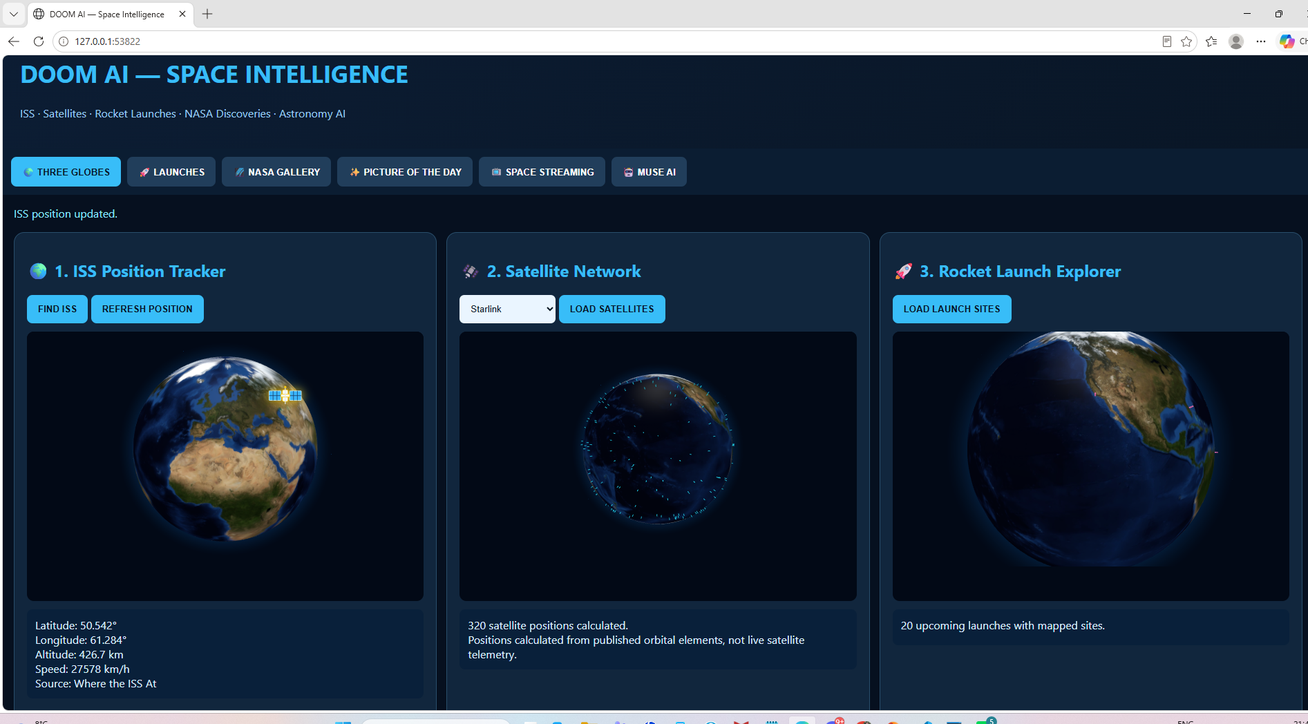
SPACE INTELLIGENCE - THREE INTERACTIVE GLOBES

Slide 15
FLIGHT INTELLIGENCE
MAIN FEATURES
Interactive 3D Earth globe showing aircraft positions and movement.
Real aircraft observations using the OpenSky Network when available.
Aircraft selection with geographic position, altitude, speed, and heading information where provided.
Regional aviation exploration with animated aircraft markers.
Separate simulated demonstration mode for visual learning.
TECHNOLOGIES USED
Python, HTML, CSS, JavaScript, Globe.gl, and OpenSky Network API.
PURPOSE
To help users explore global aviation activity and understand aircraft movement through interactive visualization.
DATA TRANSPARENCY
Real aircraft observations and simulated aircraft are distinguished. Departure and destination information may not be available from the public feed.

Slide 16
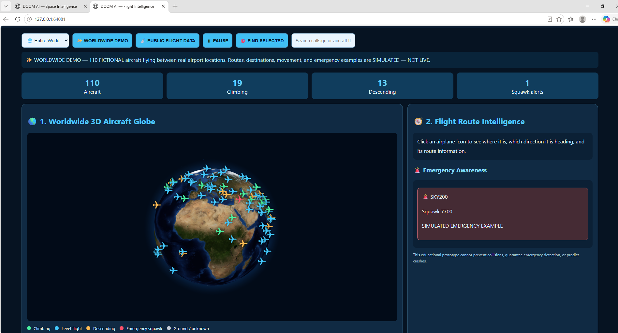
FLIGHT INTELLIGENCE - GLOBAL AIRCRAFT VISUALIZATION

Slide 17
COMMUNICATION IMPACT SIMULATOR
MESSAGE IMPACT ANALYSIS
MAIN FEATURES
Analyzes messages using rule-based tone estimation.
Displays illustrative scores for warmth, clarity, calmness, and urgency.
Shows possible audience reactions to different communication styles.
Provides alternative wording to encourage respectful communication.
Includes sample scenarios for friendly, angry, and urgent messages.
TECHNOLOGIES USED
Python and Tkinter with heuristic text-analysis rules.
PURPOSE
To help users understand how their choice of words may affect communication.
IMPORTANT NOTE
The scores are educational estimates, not scientifically validated predictions or Meta AI model outputs.

Slide 18
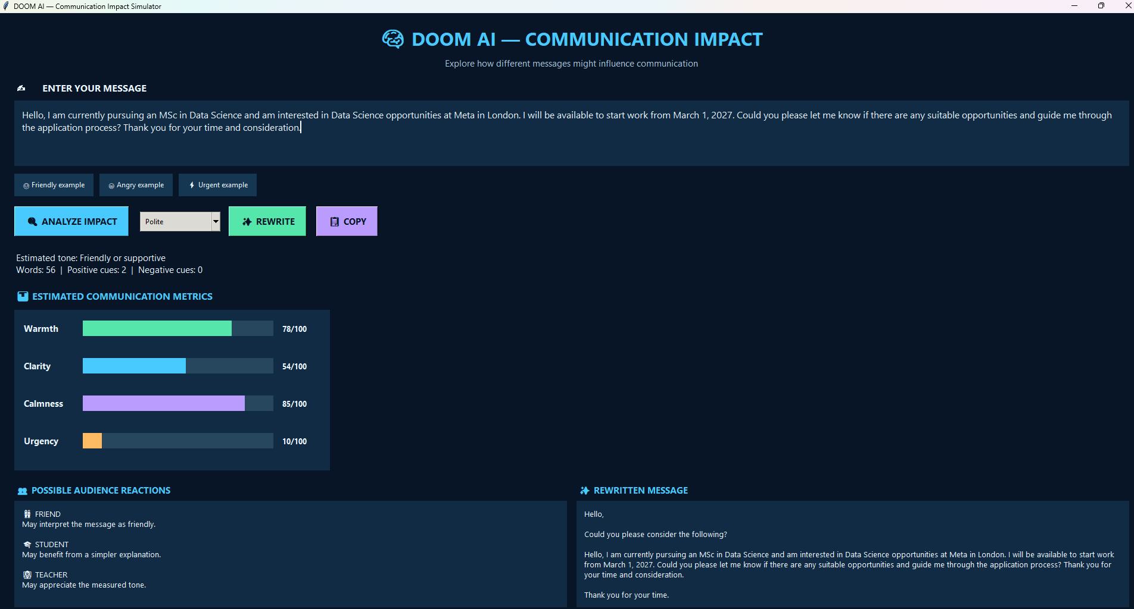
COMMUNICATION IMPACT SIMULATOR — MESSAGE ANALYSIS

Slide 19
EARTH QUEST
INTERACTIVE EARTH QUEST
MAIN FEATURES
Interactive 3D Earth globe for exploring geography.
Educational markers for cities, volcanoes, oceans, forests, and wildlife.
Illustrative air and sea routes for geographic learning.
Six environmental conservation challenges with scoring.
Science explanations supporting each learning activity.
TECHNOLOGIES USED
Python, HTML, JavaScript, and Globe.gl.
PURPOSE
To make Earth science, geography, and environmental conservation engaging through interactive learning.
DATA NOTE
Geographic markers and routes are educational references, not live tracking data.

Slide 20
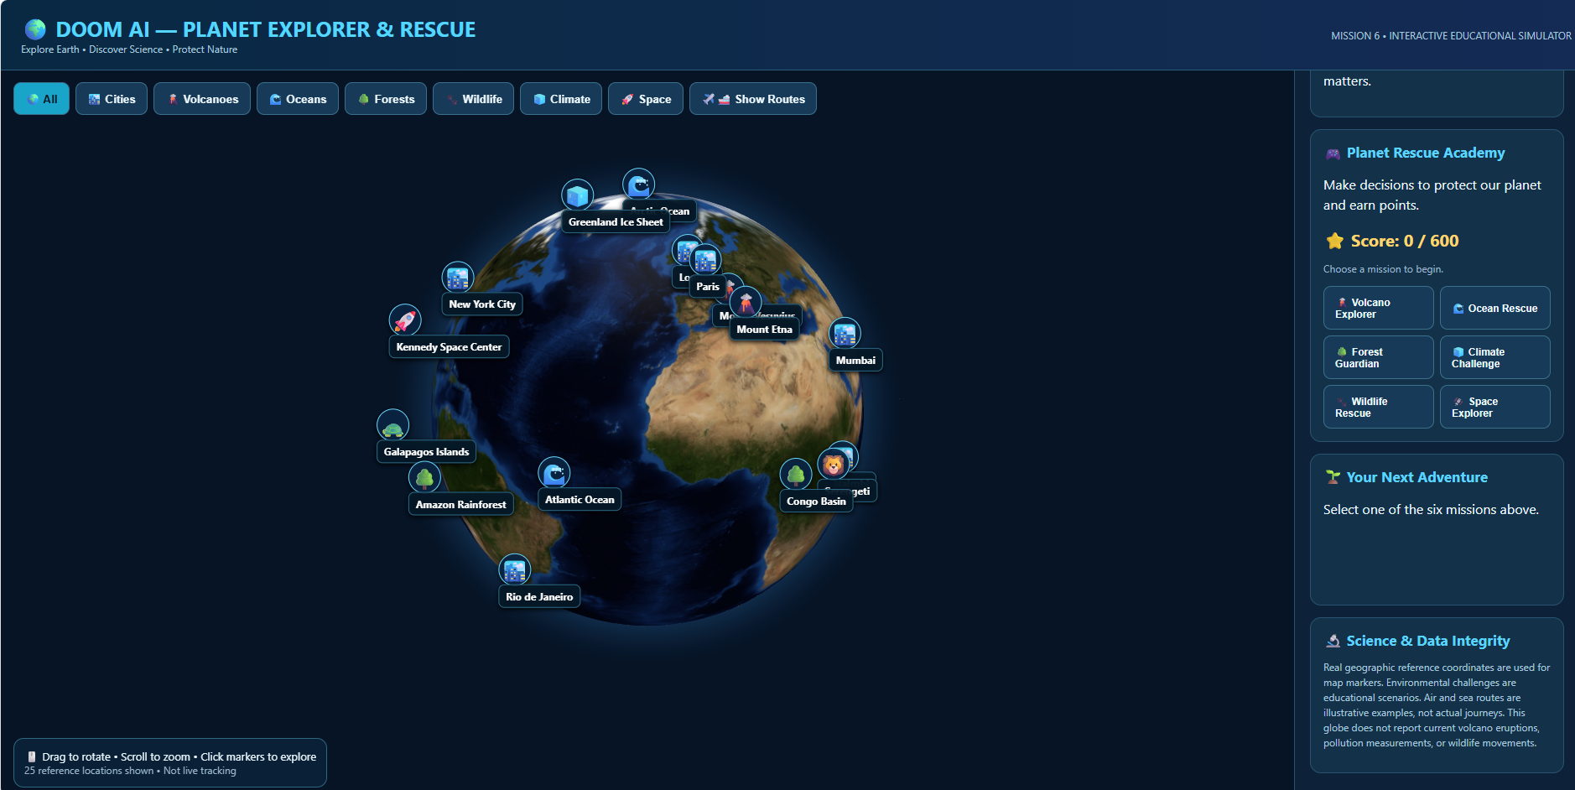
EARTH QUEST - INTERACTIVE CONSERVATION MISSION.

Slide 21
WILDLIFE GUARDIAN
WILDLIFE CONSERVATION
MAIN FEATURES
Interactive 3D Earth globe displaying wildlife habitat locations.
Explore 12 animal habitat reference markers across different regions.
Animal information covering habitats, environmental threats, and conservation actions.
Wildlife category filters for mammals, ocean animals, and polar wildlife.
Six interactive wildlife rescue challenges with educational scoring.
TECHNOLOGIES USED
Python, HTML, JavaScript, and Globe.gl.
PURPOSE
To raise awareness about endangered wildlife, habitat protection, and environmental conservation through interactive learning.
DATA NOTE
Animal markers represent educational habitat locations, not live GPS tracking of individual animals.

Slide 22
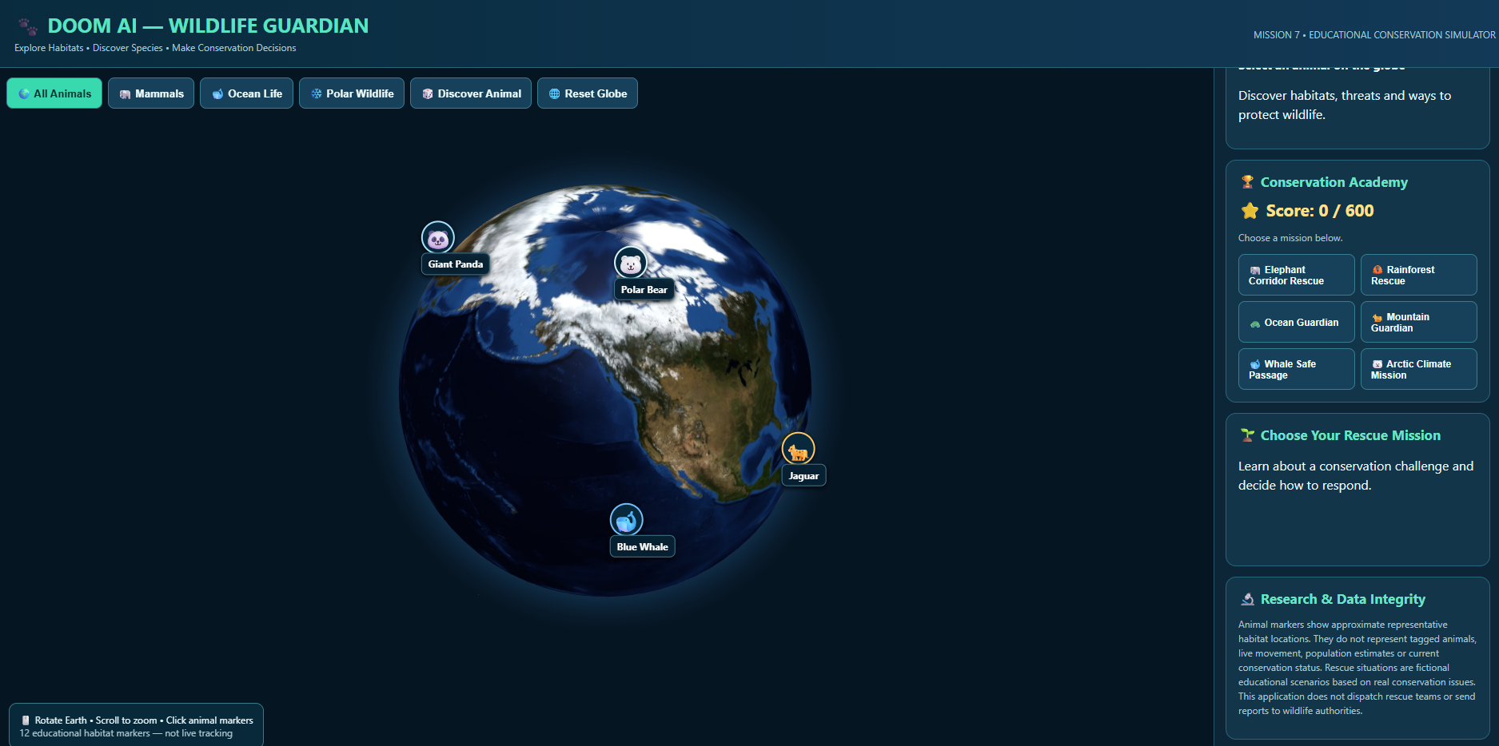
WILDLIFE GUARDIAN - 3D HABITAT EXPLORATION

Slide 23
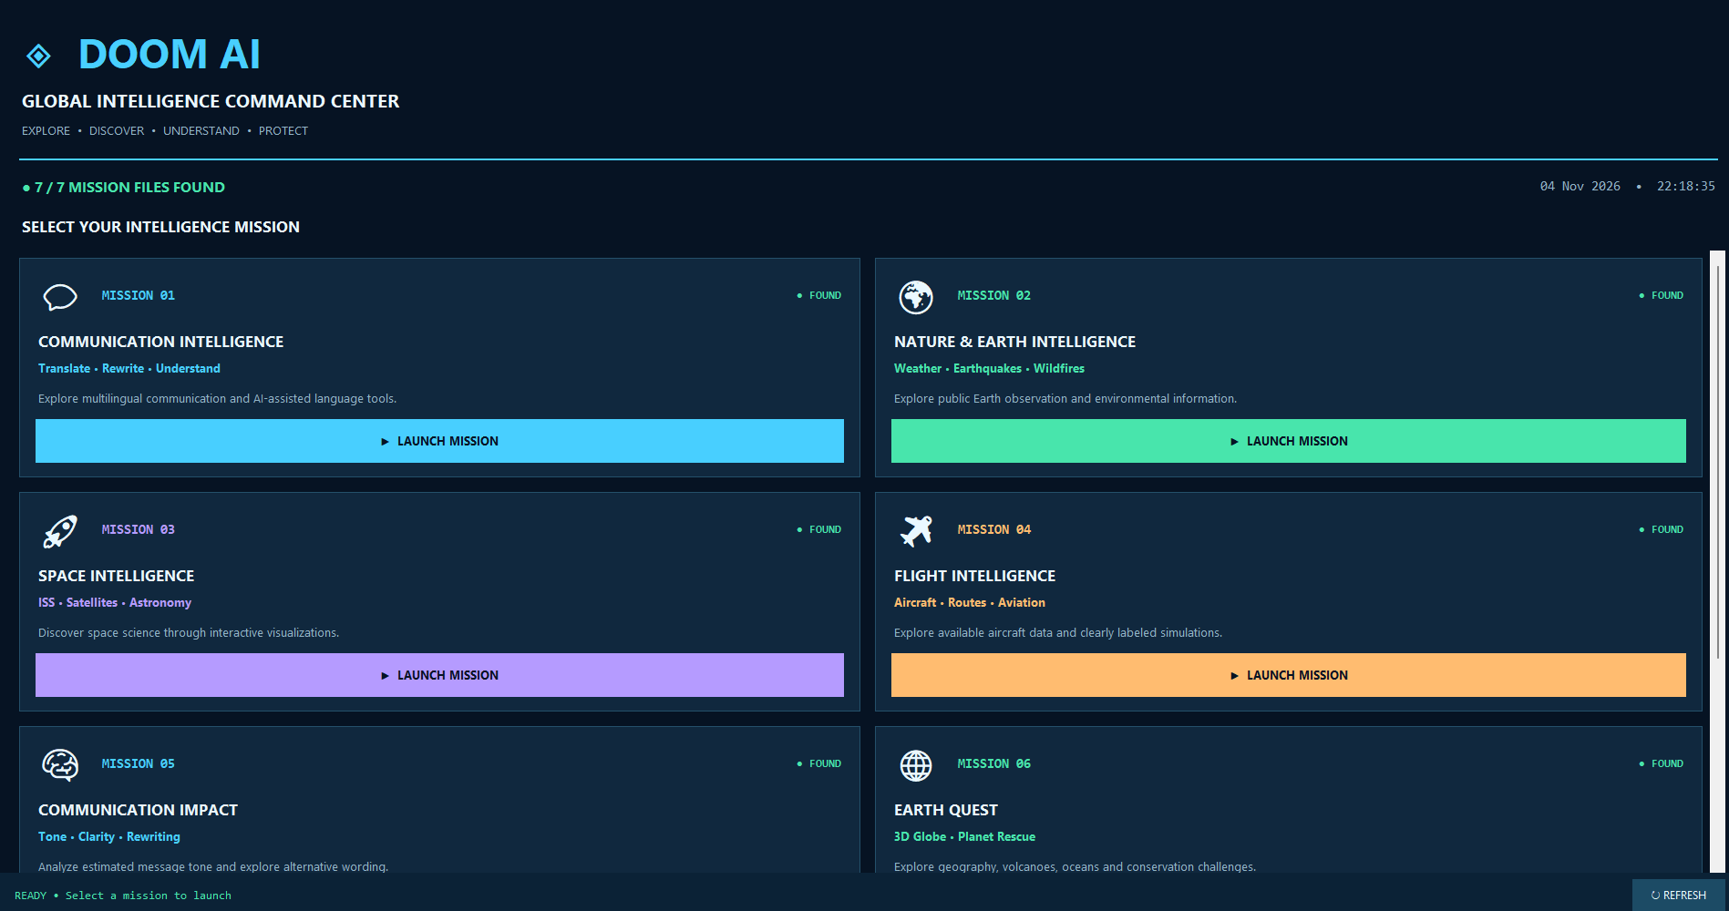
DOOM AI
SEVEN MISSIONS, ONE PLATFORM
One unified Python launcher connecting seven interactive intelligence and educational missions.

Slide 24
DEVELOPMENT CHALLENGES & LIMITATIONS
TECHNICAL CHALLENGES
Integrating multiple Python applications and browser-based 3D visualizations into one launcher.
Configuring Meta Muse Spark 1.3 API credentials and handling environment-variable errors.
Working with public APIs that may provide incomplete information or become temporarily unavailable.
Distinguishing real aircraft observations, calculated satellite positions, and simulated demonstrations.
CURRENT LIMITATIONS
Some AI features depend on network access and valid API credentials.
Communication Impact scores are heuristic educational estimates.
Wildlife habitats and Earth Quest locations are reference data rather than live tracking.
NEXT STEP
Improve error handling, automated testing, data reliability, and accessibility.

Slide 25
FUTURE DEVELOPMENT: DOOM AI LENS
PROPOSED FEATURE - DOOM AI LENS
Camera and photo-based recognition of plants, animals, and everyday objects.
AI-assisted educational explanations about identified subjects.
Wildlife habitat information, environmental threats, and conservation guidance.
FURTHER IMPROVEMENTS
Expanded multilingual support and accessibility features.
More reliable API connections with retries and clear error messages.
Improved performance for interactive 3D visualizations.
Automated testing and clearer identification of data sources.
VISION
To develop DOOM AI into a more accessible global learning and exploration platform.

Slide 26
REFERENCES & ACKNOWLEDGMENTS
AI AND DEVELOPMENT
Meta Muse Spark 1.3 - AI-assisted language features
Visual Studio Code - Development environment
Python, Tkinter, HTML, CSS, JavaScript - Application development
EARTH AND ENVIRONMENT
NASA Worldview - Earth imagery
NASA EONET - Natural-event information
USGS - Earthquake information
Open-Meteo - Weather information
OpenStreetMap / Nominatim - Geographic place identification
SPACE AND AVIATION
NASA - Astronomy imagery and space resources
CelesTrak - Satellite orbital information
Skyfield - Satellite position calculations
TheSpaceDevs - Rocket launch information
OpenSky Network - Aircraft observation data
VISUALIZATION AND AUDIO
Globe.gl / Three.js - Interactive 3D globes
gTTS - Text-to-speech
pygame - Audio playback
ACKNOWLEDGMENT
Thanks to the open-data providers, open-source developers, and Meta Global AI Developer Hackathon 2026 organisers.

Slide 27
META GLOBAL AI DEVELOPER HACKATHON 2026
TRACK
Indie Developer Track
PROBLEM STATEMENT
Build for Your World
PROJECT
DOOM AI - Digital Observatory of Our Multiverse
CORE INNOVATION
Seven interactive missions brought together through one Global Intelligence Command Centre.
META AI INTEGRATION
Meta Muse Spark 1.3 supports AI-assisted communication and language processing in the configured application.
DEVELOPER
ABINESH BOOPAL

Slide 28
DOOM AI
Digital Observatory of Our Multiverse
One Platform. Seven Missions. A World of Discovery.
Developed by ABINESH BOOPAL
Meta Global AI Developer Hackathon 2026
THANK YOU FOR EXPLORING DOOM AI !

